Slide 1

KONE API - Introduction
KONE – IBM HACKATHON

Slide 2
Introduction
The API implementation is run on IBM Bluemix platform and it is published with IBM API Connect API management service which is also used to host the developer portal. Site devices are being handled and communicated with using IBM IoT platform

Slide 3
API Features
Lift call
API Consumer is able to make a lift call through the API.
Destination call
Monitoring
API consumer can monitor the state of a lift or the state of a lift call.
Call monitoring
Site description
API consumer can fetch information about the site and it’s configuration.
KONE Cloud APIs are fully hypermedia-driven REST APIs, utilizing HATEOAS (Hypertext As The Engine Of Application State)
A client that wants to call an elevator, will create an elevator call resource using HTTP POST method. This will return a unique URL to the created resource. After this, the client may follow any changes to the call (such as assigned elevator) resource by GETting the URL. Additionally, the client may cancel the call with DELETE HTTP method.

Slide 4
Authentication to API
There are fixed clientId / client secret combinations in APIConnect for 3rd party
This client id / client secret will be shared with to each team separately

Slide 5
Start using API
In your application, use the API endpoint and follow the relations provided by the response content. You should not hardcore other URLs in your application. Specify the headers below for each request.
Content-Type: application/vnd.collection+json Accept: application/vnd.collection+json x-ibm-client-id: [YOUR APPLICATION SPECIFIC ID] x-ibm-client-secret: [YOUR APPLICATION SPECIFIC SECRET]

Slide 6
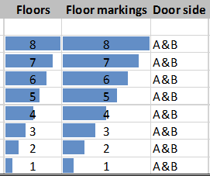
Simulator - Lab setup

Slide 7
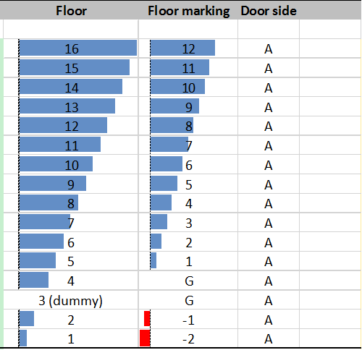
Real lift setup

Slide 8
Terms in API
Building
Id
Site Name
Name
Country
City
Location
Floor
Id
Typical level
Index
name
Area
Id
Exit
Short Name
Long Name

Slide 9
Terms in API
Lift
Id
KEN
Type
Monitoring Enabled
LiftState
Id
Moving direction
Moving state
Lastupdate
Deck
Id
Index
Door
Id
Name
Side

Slide 10
Terms in API
Door State
Id
State
Name
Call

